Slide 1
ORM tool - Hibernate

Slide 2
Love of Objects
Programmers love objects
Objects are normally ephemeral
Programming languages provide object persistence, but it is fragile
Databases provide robust data persistence.
So… need way to persist object data in the database

Slide 3
Object-Relational Mapping (ORM)
A software system that shuttles data back and forth between database rows and objects
Appears as a normal database user to the database
Can share the database and tables with other apps
objects
ORM
Database

Slide 4
Why ORM
Reduces Development Time.
It makes development more object-oriented.
Overcomes vendor specific SQL differences
Eliminates the need for repetitive SQL code.

Slide 5
ORM Tools
Hibernate
TopLink
EclipseLink
OpenJPA
MyBatis (formally known as iBatis)

Slide 6
Hibernate
Hibernate is a Java framework that simplifies the development of Java application to interact with the database. It is an open source, lightweight, ORM (Object Relational Mapping) tool.

Slide 7
Session
A Session is used to get a physical connection with a database.
The main function of the Session is to offer, create, read, and delete operations for instances of mapped entity classes.
We use session factory to create session.

Slide 8
Transaction
A transaction simply represents a unit of work. In such case, if one step fails, the whole transaction fails.

Slide 9
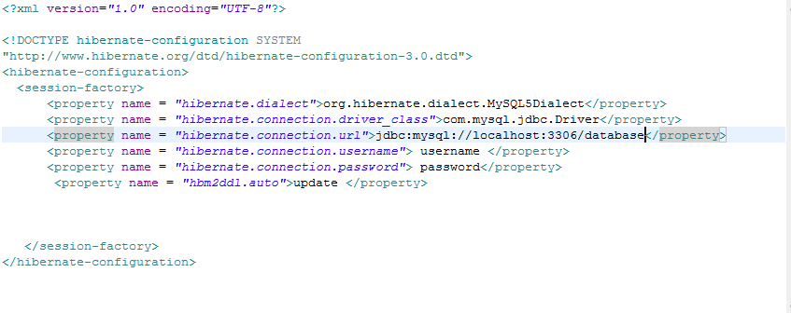
Hibernate Configuration

Slide 10
Hibernate Annotations
@Entity
@Table
@Id and @GeneratedValue
@Column

Slide 11
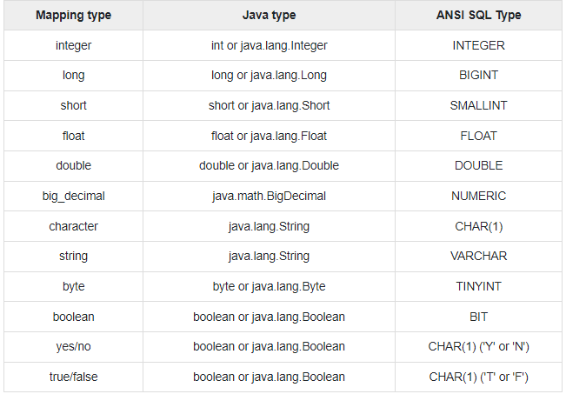
Mapping Types

Slide 12
Hibernate - Query Language
Hibernate Query Language (HQL) is an object-oriented query language, similar to SQL, but instead of operating on tables and columns, HQL works with persistent objects and their properties

Slide 13
Association Mappings
One To One
One To Many
Many To Many

Slide 14


